Slide 1




Portfolio Website Using HTML & CSS
at
IIT Kanpur
Harshit Srivastava
2200100100163

Slide 2

Topics Covered
2
HTML-Hyper Text Markup Language
CSS- Cascade Style Sheets
JS-Java Script

Slide 3
Introduction
3
Portfolio Website
Simply a personalised website for user to showcase their work experience, projects made and other achievments in extra ciriculars.
Portfolip vs Resume vs CV
(A CV is mostly used for academic Jobs, while a Resume is used for most Jobs and a Portfolio is used for creative and art-based jobs.)

Slide 4
Methodology
4
Define Purpose
Plan Content
Develop Website
Test and Deploy
Maintainance

Slide 5
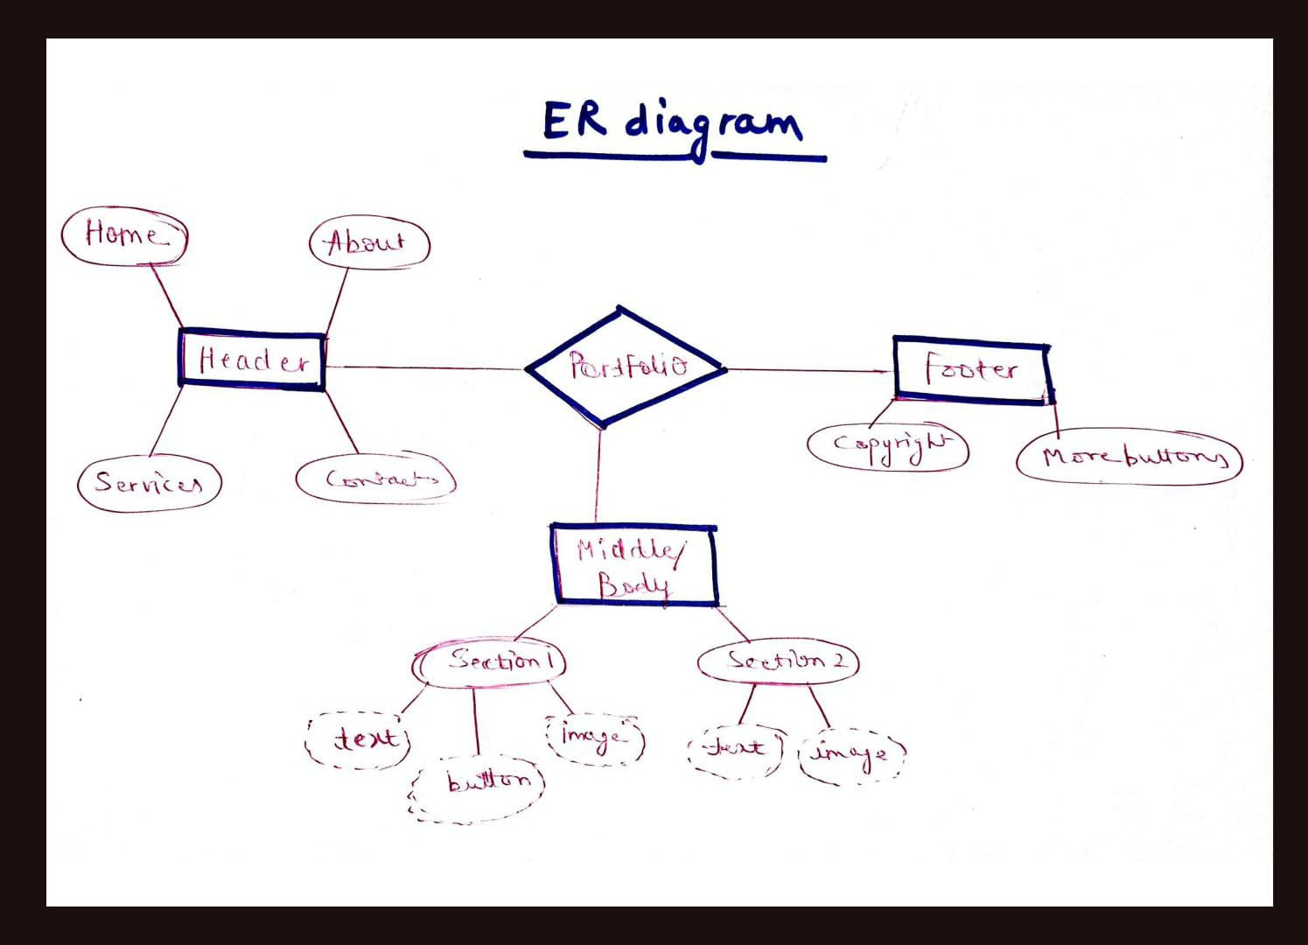
ER Diagram/ DFD
5

Slide 6
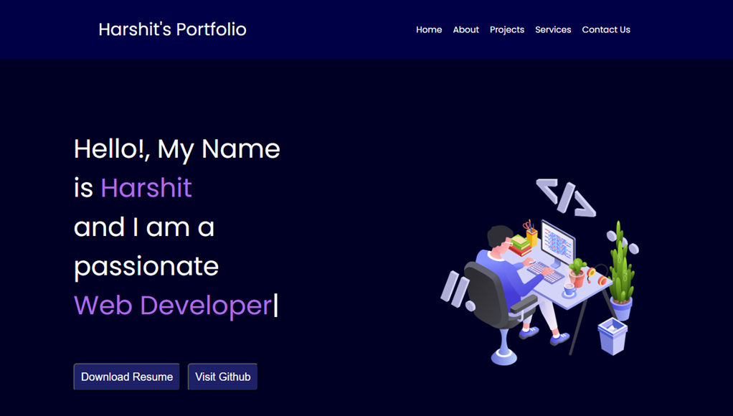
Results / Snapshots
6

Slide 7
Limitations
7
Maintenance
Security
Costs

Slide 8
Future Scope
8
Portfolio plays an important role in creating an impression in front of the interviewer and also showcases your talent in a creative rather organised manner .

Slide 9
References
9
Code With Harry
GitHUB Repositories
Google Fonts
Pintrest

